Slide 1
Predicting High-Traffic Recipes
Alexandros Papalexandris
4/9/26

Slide 2
The Business Problem
Product Manager manually picks one recipe to feature on the homepage each day
Featuring a popular recipe boosts site-wide traffic by up to 40%
No systematic way to know in advance if a recipe will be popular
Goal
Predict which recipes will drive High traffic, correctly at least 80% of the time

Slide 3
The Data
947 recipes: nutrition info, category, servings, traffic outcome
Data quality issues found & fixed:
Duplicate category label merged (Chicken Breast → Chicken)
Inconsistent text in servings cleaned ("4 as a snack" → 4)
Missing traffic values recoded as "Low"
52 recipes missing all nutrition data → removed
Final dataset: 895 recipes, fully cleaned

Slide 4
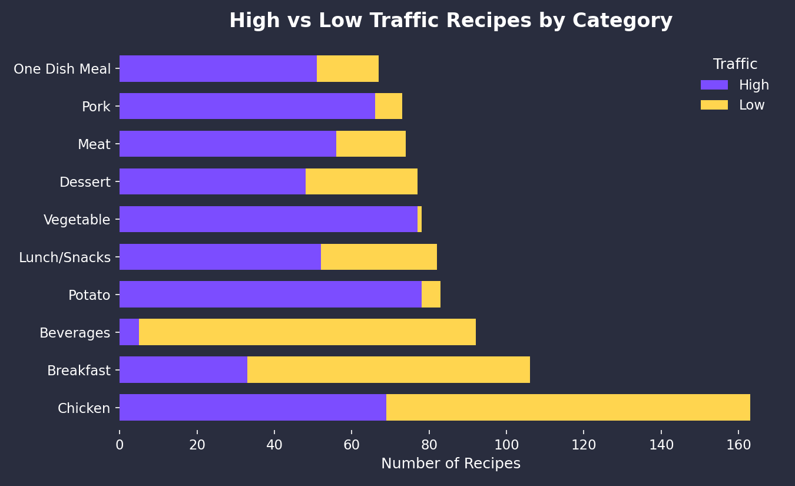
Category alone is a powerful predictor:
Vegetable, Potato, Pork: 90%+ High traffic
Beverages, Breakfast: under 31% High traffic

Slide 5
Modeling
Approach
Binary classification problem (High traffic vs Low traffic)
Baseline: Logistic Regression Simple, interpretable
Comparison: Decision Tree + XGBoost Rule-based well suited to strong category patterns

Slide 6
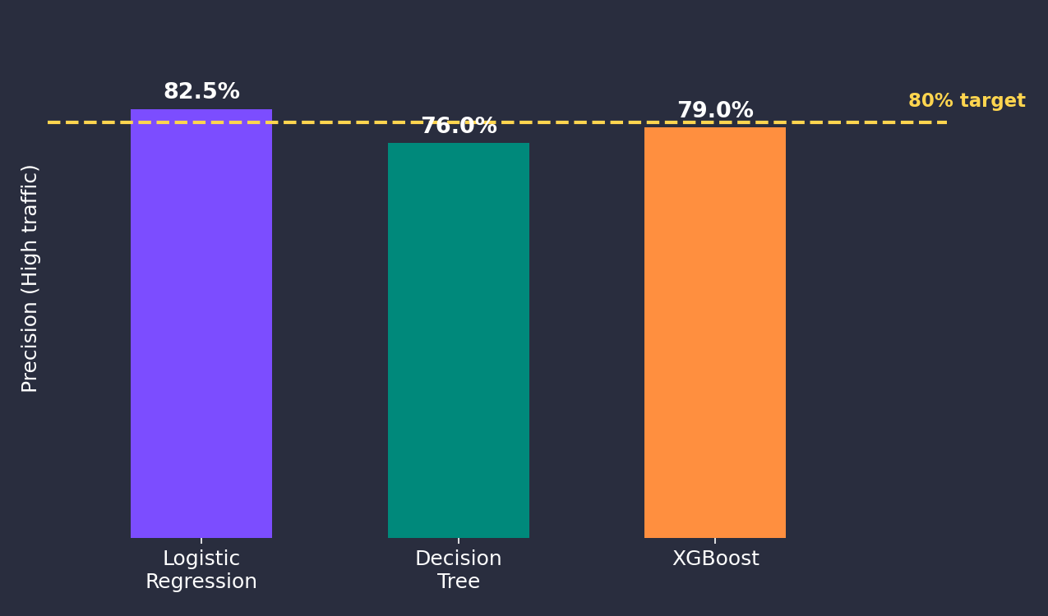
Model Results
Simpler model won - Logistic Regression beat both tree-based models and cleared the 80% target

Slide 7
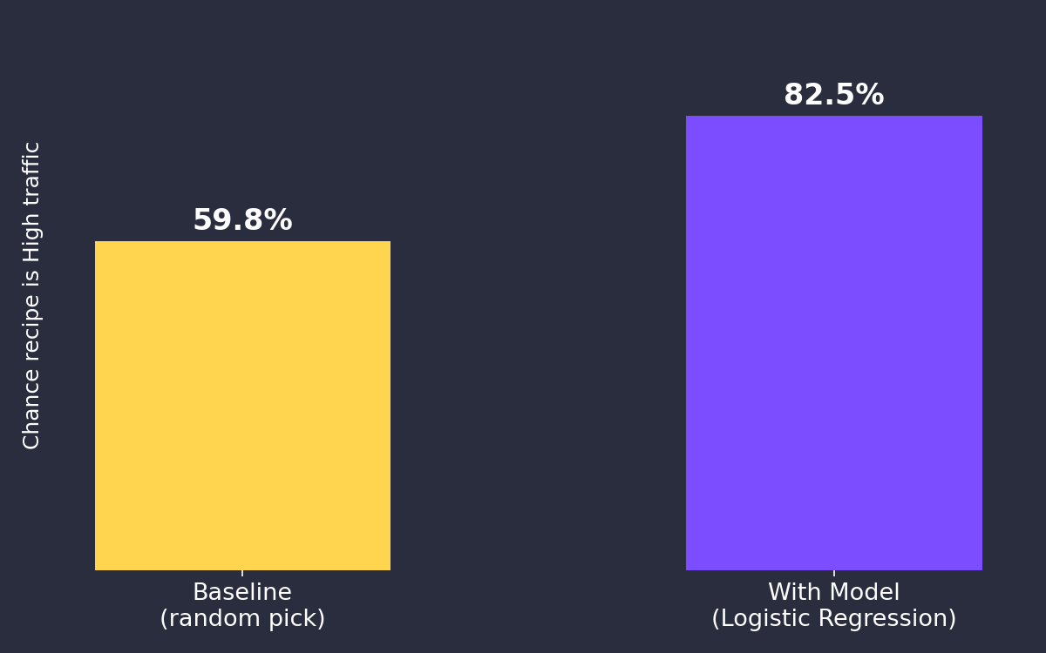
Business Impact
Roughly 23% points of improvement over picking recipes without any data-driven guidance

Slide 8
Recommendations
Deploy the model - it already exceeds the 80% target
Prioritize Vegetable, Potato, and Pork recipes - no model needed for this
Use the model to rank recipes, keeping the Product Manager's final creative say

Slide 9
Next Steps
Monitor models precision on live homepage picks going forward
Revisit and retrain the model as more data accumulates
Open to questions

Slide 10
Thank you!

